Slide 1
INVERSION OF ANTENATAL PYRAMID
Dr.Malathi G Prasad Dr. Bavaharan
Fetal Medicine Centre Trichy

Slide 2
Pregnancy Care
19th century –pregnancy care for wealthy
20th century – High MMR & IMR → prenatal care
16 , 24 , 28 & fortnightly
No rationale on timing or clinical content

Slide 4
80 yr old Pyramid of care has shifted in
2011

Slide 5
AIM
Early screening of Fetal Aneupliodies
Early Diagnosis of Fetal Abnormalities
Early Screening for Miscarriage and Stillbirth
Early Screening for Preeclampsia
SGA
Preterm Delivery

Slide 6
New 1st Trimester Scan Protocol
NT
Nasal Bone
Early survey
Doppler
Ductus Venosus
Tricuspid Valve flow
Hepatic artery flow
Uterine artery Doppler

Slide 7
The Protocol

Slide 8
Sensitivity of screening
False Positive Rate 5% | Detection rate 61% for Down 63% for Trisomy 18 | 1st trimester (Biochemical)
<5% for Down <1% for Trisomy 18 | 70% for Down 80% for Trisomy 18 | 2nd trimester (Biochemical)
10% | 33% | Age alone
8% | 72% for Down 68% for Trisomies | Ultrasound NT
4% | 90% Aneuploies | Combined test

Slide 9
Timing of Ultrasound and Biochemistry
first-trimester combined screening for trisomy 21 is to perform biochemical (B-HCG ,PAPP-A) ultrasonographic testing & include maternal age
One-stop clinic for assement of Risk – OSCAR
The ideal gestation for OSCAR is 12 weeks because the aim of the first-trimester scan is not just to screen for trisomy 21 but also to diagnose an increasing number of fetal malformations

Slide 10
Assessment
If Combined Risk → 1:50 → Invasive testing
<1:1000 – Screen Negative
1:50 to 1:1000
absence of the nasal bone,
increased impedance to flow in the ductus venosus and tricuspid regurgitation

Slide 11
Biochemical
In trisomy 21 , Serum free β-hCG is about twice as high and PAPP-A is reduced to half compared with euploid pregnancies
Trisomies 18 and 13,Serum free β-hCG and PAPP-A are decreased
In cases of sex chromosomal anomalies, maternal serum free β-hCG is normal and PAPP-A is low
Triploidies -- free β-hCG and PAPP-A is low

Slide 12
2D USG

Slide 13
Nuchal Translucency

Slide 14
Protocol for measurement of nuchal translucency
11 to 13 weeks 6days.
CRL→45 and 84mm.
The magnification of the image should be such that the fetal head and thorax occupy the whole screen.
A mid-sagittal view of the face
The fetus should be in a neutral position, with the head in line with the spine
Distinguish between fetal skin and amnion.
The widest part of translucency must always be measured.
Measurements should be taken with the inner border of the horizontal line of the callipers placed ON the line that defines the nuchal translucency thickness - the crossbar of the calliper should be such that it is hardly visible as it merges with the white line of the border, not in the nuchal fluid.
Turn the gain down.
A new approach for the measurement of NT which improves the accuracy of measurements, is with the use of a semi-automated technique.

Slide 15
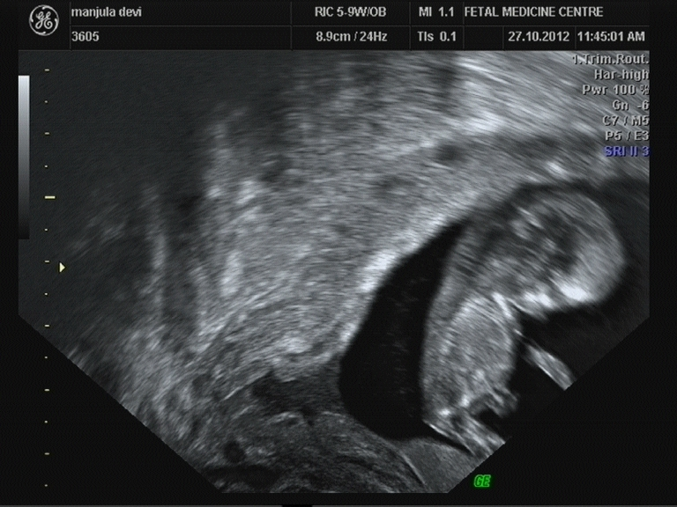

Slide 17
Overall outcome based on NT

Slide 18
Risk of a cardiac defect
NT measurement Cardiac risk
<95th centile 0.16%
2.5-3.4 mm 1%
3.5-4.5 mm 3%
4.5-5.4 mm 7%
5.5-6.4 mm 20%
Above 6.5 mm 30%

Slide 19
Fetal anomalies associated with increased NT
Major cardiac defect
Diaphragmatic hernia
Exomphalos
Body stalk anomaly
Skeletal defects.
Genetic syndromes
Congential adrenal hyperplasia
Fetal akinesia sequence
Noonan syndrome
Smith-Lemli-Opitz
Spinal muscular atrophy

Slide 20
Interpretation of NT
NT 2- 3.0
NT >3.0
If Karyotyping is normal
Karyotyping
Anomaly & Fetal Echo
Combined test
Increased NT Points to a possible Abnormality
UNIVERSAL SCREENING – Combined Test -- OSCAR

Slide 21
Nasal bone

Slide 22
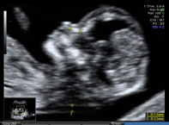
Protocol for assessment of the fetal nasal bone
The gestational period must be 11 to 13 weeks and six days.
The magnification
A mid-sagittal view of the face should be obtained.
The ultrasound transducer should be held parallel to the direction of the nose and should be gently tilted from side to side to ensure that the nasal bone is seen separate from the nasal skin.
The echogenicity of the nasal bone should be greater that the skin overlying it. In this respect, the correct view of the nasal bone should demonstrate three distinct lines: the first two lines, which are proximal to the forehead, are horizontal and parallel to each other, resembling an "equal sign". The top line represents the skin and bottom one, which is thicker and more echogenic than the overlying skin, represents the nasal bone. A third line, almost in continuity with the skin, but at a higher level, represents the tip of the nose.
When the nasal bone line appears as a thin line, less echogenic than the overlying skin, it suggests that the nasal bone is not yet ossified, and it is therefore classified as being absent.

Slide 23
Down`s syndrome

Slide 24
Interpreting Nasal Bone
Nasal Bone
Seen Not seen
Combined Test Combined Test
<1:50 >1:50 <1:50 >1:50
Follow up Invasive testing Other Markers Invasive testing
If other parameters are suspicious – Invasive testing

Slide 25
Open Spina Bifida
In almost all cases of open spina bifida →associated Arnold-Chiari malformation
→ Consequence of leakage of cerebrospinal fluid into the amniotic cavity and hypotension
in the subarachnoid spaces → caudal displacement of the brain and obstructive hydrocephalus.
In the second trimester of pregnancy, the manifestations of the Arnold- Chiari malformation are the lemon and banana signs
Caudal displacement of the brain is apparent at 11–13 weeks in the same midsagittal view of the fetal face
the lower part of the fetal brain between the sphenoid bone anteriorly and the occipital bone posteriorly can be divided into the brain stem in the front and a combination of the fourth ventricle and cistern magna in the back
In fetuses with open spina bifida, the brain stem diameter is increased and the diameter of the fourth ventricle-cisterna magna complex is decreased.
Hypoplasia of vermis & cerebellum can also be picked up in 1st trimester
Intracranial Translucency

Slide 26
Intracranial Translucency

Slide 27
1ST Trimester Detectable Abnormalities
Body stalk anomaly, anencephaly, alobar holoprosencephaly, exomphalos, gastroschisis megacystis.
Amelia or Phocomelia

Slide 28
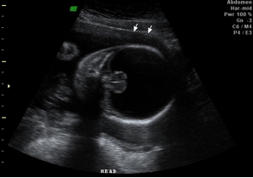
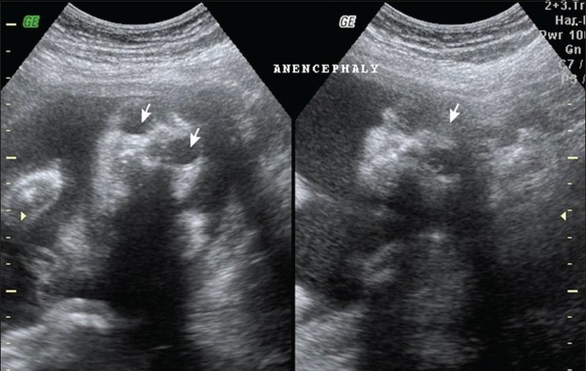
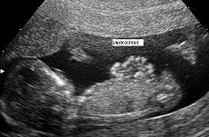
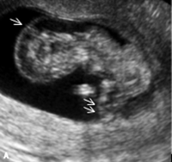
Detectable abnormalities

Slide 29
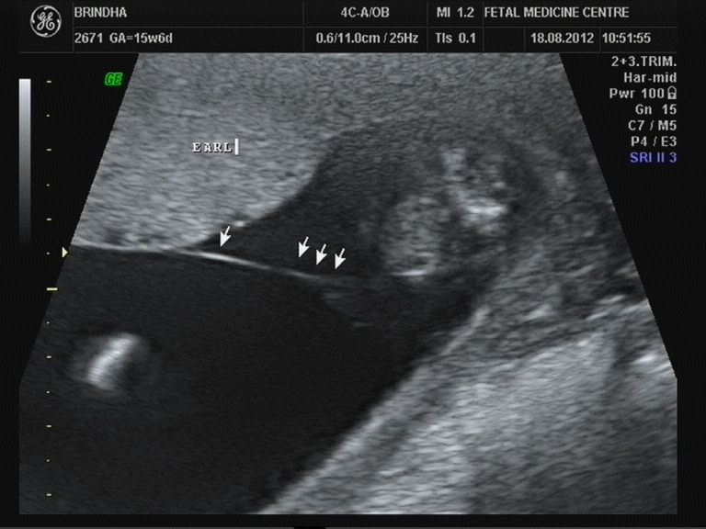
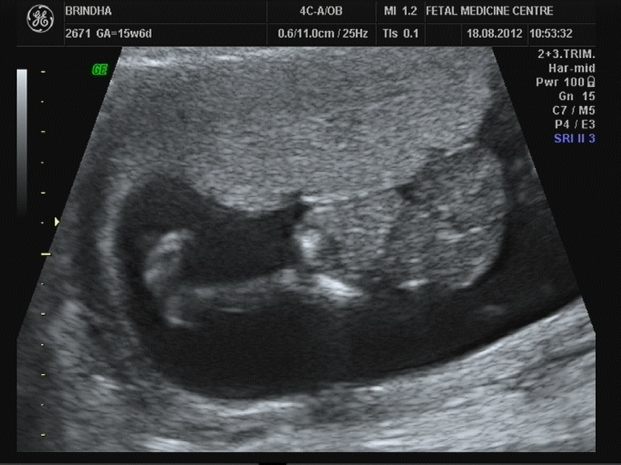
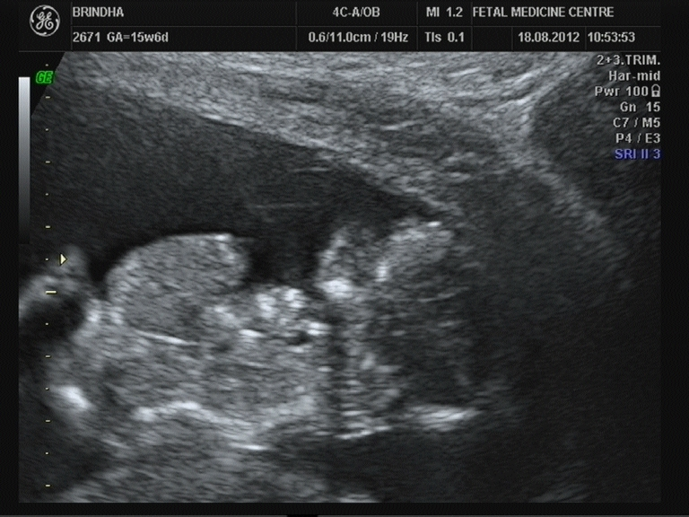

Slide 30
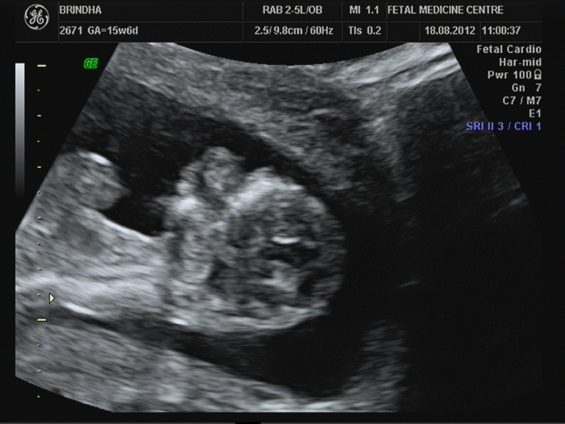
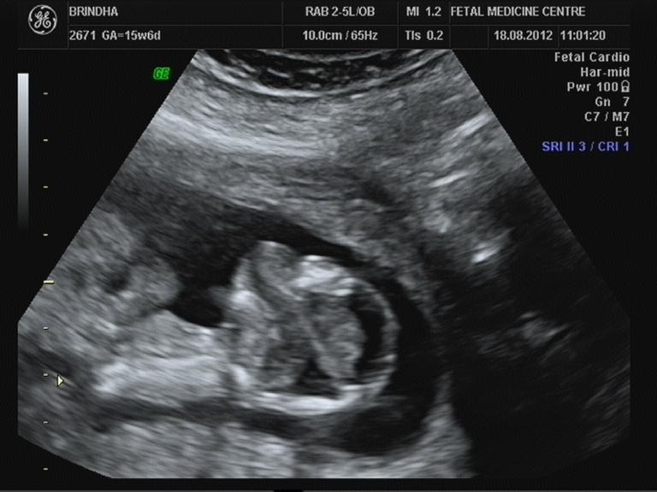

Slide 31
1st trimester Undetectable abnormalities
because they are manifested only during the second or third trimester of pregnancy,
microcephaly,
agenesis of the corpus callosum,
semilobar holoprosencephaly,
hypoplasia of the cerebellum or vermis,
cystic adenomatoidmalformation or
pulmonary sequestration
bowel obstruction.

Slide 32
DOPPLER IN 1ST TRIMESTER

Slide 33
Ductus Venosus

Slide 34
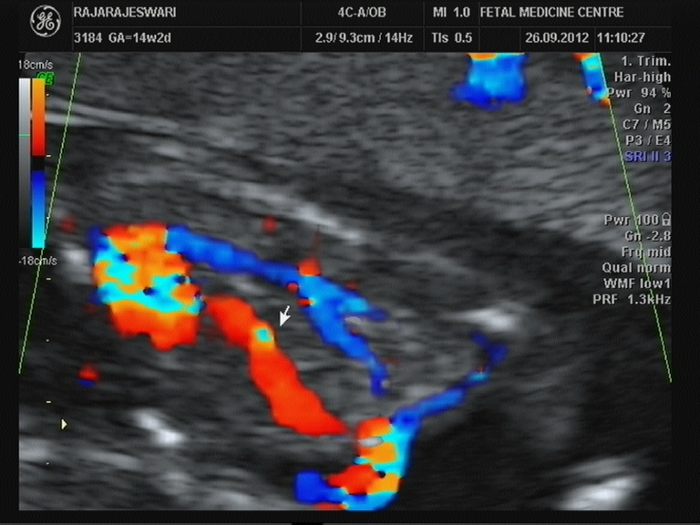
Protocol for the assessment of the ductus venosus
The gestational period must be 11 to 13 weeks and six days.
The examination should be undertaken during fetal quiescence.
The magnification of the image → fetal thorax and abdomen occupy the whole image.
A right ventral mid-sagittal view of the fetal trunk should be obtained and color flow mapping should be undertaken to demonstrate the umbilical vein, ductus venosus and fetal heart.
The pulsed Doppler sample volume should be small (0.5-1.0 mm)
The insonation angle→less than 30 degrees.
The filter should be set at a low frequency (50-70 Hz)
The sweep speed should be high (2-3 cm/s) so that the waveforms are spread allowing better assessment of the a-wave.

Slide 36
Interpretation of Ductus
Ductus Venosus
Normal a wave reversal of a wave
Combined Test Combined Test
<1:50 >1:50 <1:50 >1:50
Anomaly Invasive testing Other Markers Invasive testing
Anomaly & fetal Echo

Slide 37
DUCTUS VENOSUS FLOW
NO OF CASES REVERSAL ANEUPLOIDIES CARDIAC ANOMALIES
942 18 4 9

Slide 38
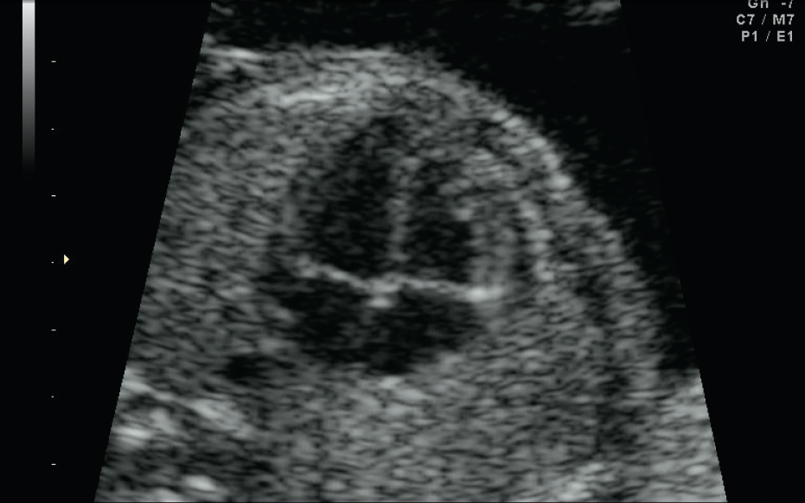
Tricuspid valve

Slide 39
Tricuspid Regurgitation

Slide 40
Interpretation of Tricuspid regurgitation
Tricuspid flow
Normal regurgitation
Combined Test Combined Test
<1:50 >1:50 <1:50 >1:50
Anomaly Invasive testing Other Markers Invasive testing
Anomaly & fetal Echo

Slide 41
Uterine artery PI
Aim of identifying women at high-risk for subsequent development of preeclampsia
screening by maternal history may detect only about 30% of those that will develop preeclampsia for a false positive rate of 5%
Improve pregnancy outcome because intensive maternal and fetal monitoring in such patients would lead to an earlier diagnosis of the clinical signs of the disease and the associated fetal growth restriction
avoid the development of serious complications through such interventions as the administration of antihypertensive medication and early delivery

Slide 42
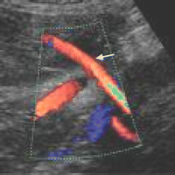
Protocol for first-trimester measurement of the uterine artery PI
11 weeks and 13 weeks and six days.
Sagittal section of the uterus
Identify the cervical canal and internal cervical os
the transducer must be gently tilted from side to side and then colour flow mapping should be used to identify each uterine artery along the side of the cervix and uterus at the level of the internal os.
Pulsed wave Doppler
sampling gate set at 2 mm to cover the whole vessel
ensuring that the angle of insonation is less than 30º.

Slide 43
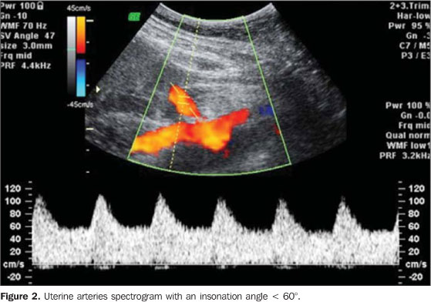

Slide 44
Interpretation of Uterine artery
Uterine artery
Prophylactic asprin
Follow up doppler at 22-24 weeks
Combined PI >2.5 or >1.5Mom
Follow up doppler & Growth scan at 28-30 weeks
BP , PAPP A , PGF
UA PI – INCREASE – impaired trophoblastic invasion of maternal spiral arterioles & their conversion to wide non muscular channels ← depend on Maternal Vasomotor tone

Slide 45
Statistics
Prospective study at FMC – 18 months
Total Sample -- 942
Screen Positive – 109
Invasive tests done for 91
Positive aneuploidies – 13

Slide 46
Early Screening for Miscarriage and Stillbirth
increased fetal NT thickness,
reversed a-wave in the fetal ductus venosus and
low maternal serum PAPP-A
PREVENTION
No intervention for miscarriage
Still Birth-closer monitoring

Slide 47
Early Screening for Preeclampsia
2% pregnancies
Evolving evidence
degree of impaired placentation and
Incidence of adverse fetal and maternal short-term and long-term consequences of preeclampsia are inversely related to the gestational age

Slide 48
PRE ECLAMPSIA
Maternal characteristics
Maternal Weight
Obesity
Preexisting HT or DM
Mean arterial pressure
Uterine artery PI
markers

Slide 49
Preecl …. contd
Biochemical tests
PAAP-A , PGF , inhibin A
Sensitivity – 90%
PREVENTION
Close Surveillance
Aspirin

Slide 50
GDM
Maternal Characteristics
Risk increses with maternal age & BMI
Family history GDM
Biochemical markers
Adiponectin
Sex hormone binding globulin
GCT AT 11-13 – Cut off -130mg/dl
Sensitivity—75%
Dietary advice , drugs

Slide 51
SGA
Maternal Characteristics
Increases with maternal age ,BMI
HT
Assisted conception
Biophysical & Biochemical markers
Inversely related to NT
Increased uterine artery PI
Increased papp-a & b-HCG
Regular monitoring for fetal growth & well being
Prophylactic asprin

Slide 52
Preterm delivery
Causes
SPONTANEOUS ONSET OF LABOUR
PROM
IATROGENIC
PREECLAMPSIA
Prevention
Role of progesterone and circlage- debatable

Slide 53
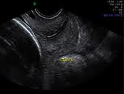
Preterm
Maternal Characteristics
Increases with maternal age ,BMI smokers HT Assisted conception
Decreased by previous normal deliveries
Biophysical & Biochemical markers
Uterine artery PI
Cevical length

Slide 54
Protocol to refresh now

Slide 55
Aim
Improve pregnancy outcome by shifting prenatal care from a series of routine visits to a more individualized patient- and disease-specific approach both in terms of the schedule and content of such visits.
USG
Low Risk
High Risk

Slide 56
2nd trimester screening

Slide 57
2nd trimester Screening

Slide 58
Conclusion
The scientific advances of the last 20 years raise the hope that many pregnancy complications can be detected as early as the 12th week of gestation.
Future research → will inevitably expand the number of conditions that can be identified in early pregnancy and define genetic markers of disease that will improve the accuracy of the a prior risk based on maternal characteristics and medical history.
New biophysical and biochemical markers will be described that may replace some of the current ones and modify the value of others.

Slide 59
Screen early Adequate knowledge Gain expertise Prevent complications
Thank you all

